Slide 1
Containers A DevOps love story ☺
Abdulrahman Azab
15, May 2019

Slide 2
Agenda (original)
09:00 - 09:30 Overview of the Linux containers technology
09:30 - 10:00 Installing Docker
10:00 - 10:30 Building Docker images 1
10:30 - 11:00 Coffee break
11:00 - 11:30 Building Docker images 2
11:30 - 12:00 Managing Docker images and containers 1
12:00 - 13:00 Lunch
13:00 - 13:00 Managing Docker images and containers 2
13:30 - 14:00 Advanced Docker features
14:00 - 14:30 Docker in continuous integration*
14:30 - 15:00 Introducing and installing Singularity
15:00 - 15:30 Coffee break
15:30 - 16:00 Building and managing Singularity containers

Slide 3
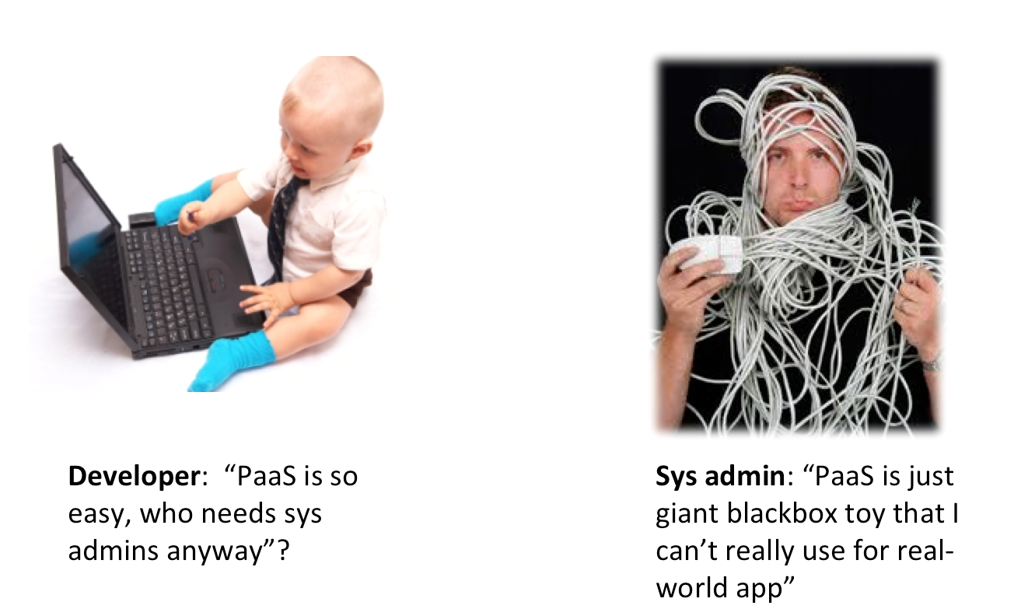
DevOps

Slide 4
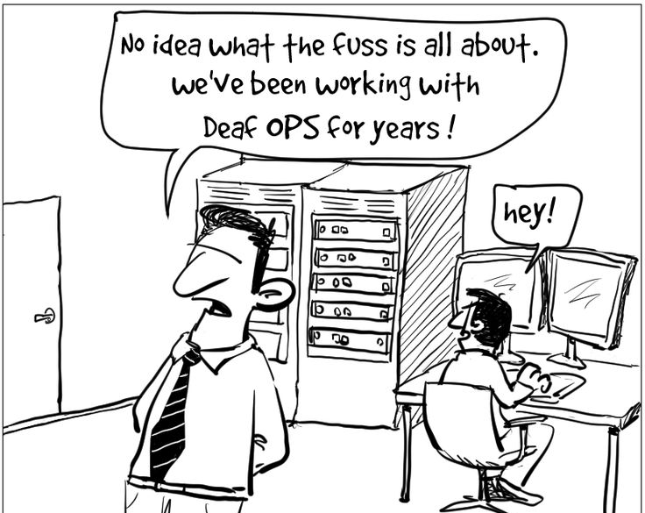
DevOps

Slide 5
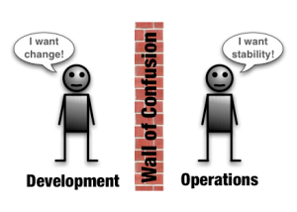
DevOps

Slide 6



Slide 7
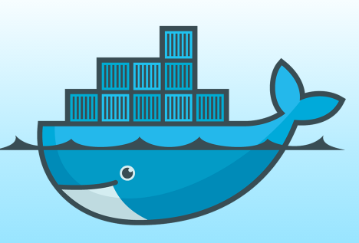
Docker
Docker is an open-source project that automates
the deployment of applications inside software
containers, by providing an additional layer of
abstraction and automation of operating system–
level virtualization on Linux.
[www.docker.com]

Slide 8
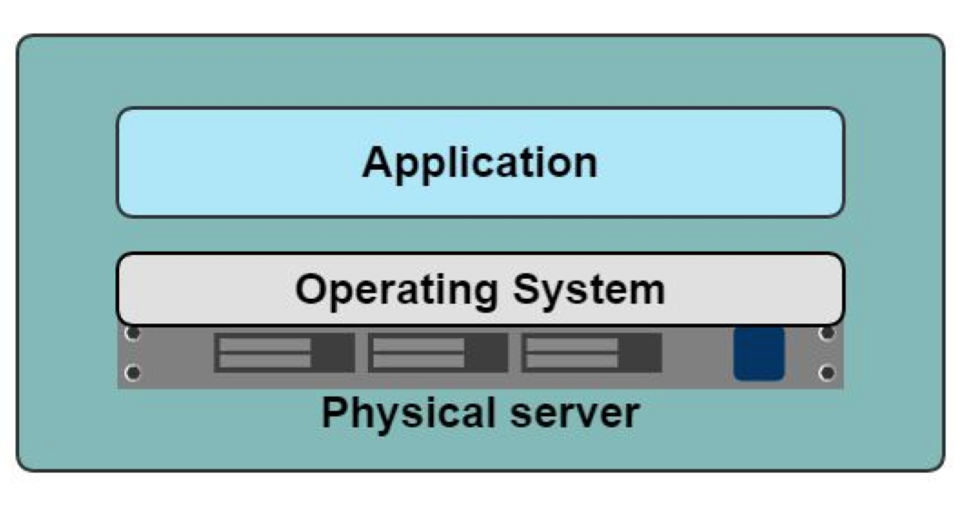
Application-Server
Slow deployment
Huge cost
Wasted resources
Difficult to Scale
Difficult to Migrate

Slide 9
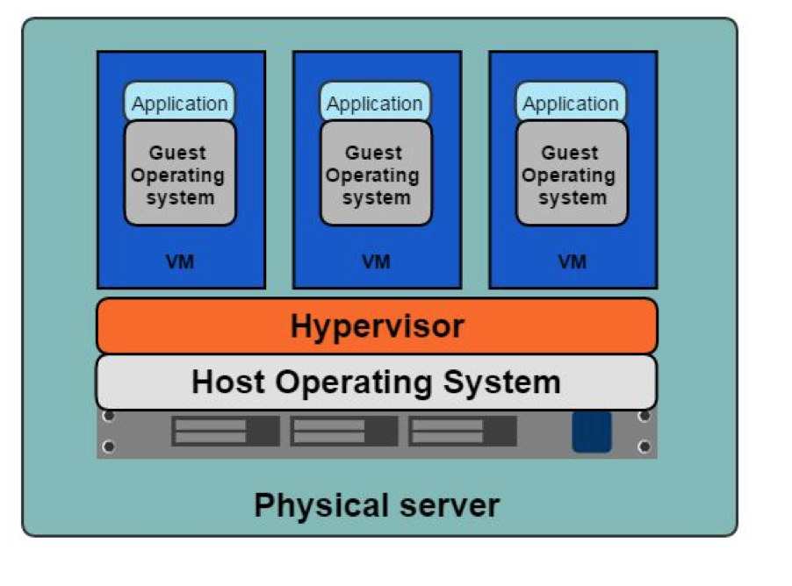
VMs
Benefits
Better resource pooling
Easier to scale
VM’s on the cloud.
Limitations
Dedicated resources for each VM (more VM = more resources).
Guest VM = Wasted resources.

Slide 10
Containers

Slide 11
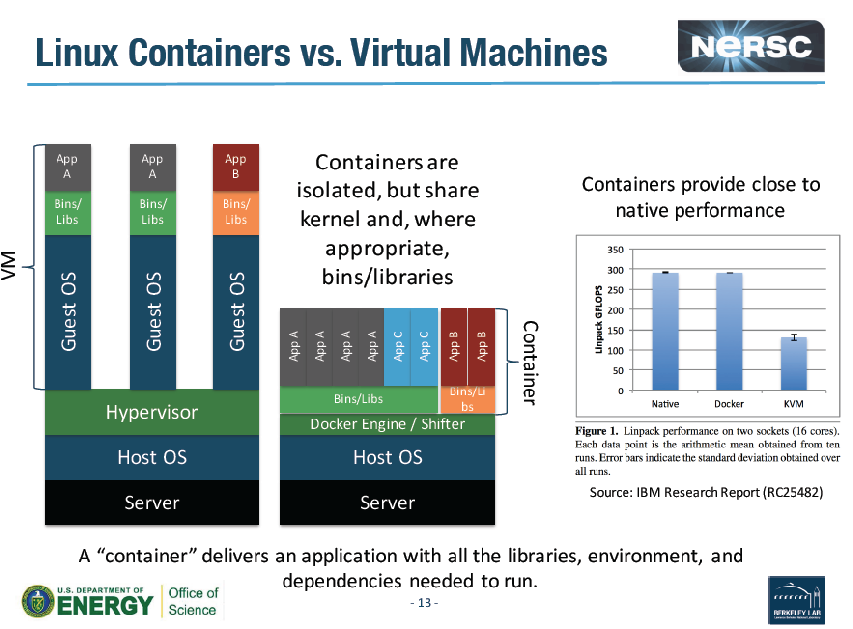
Docker
Notes:
LINPACK is a software library for performing numericallinear algebra on digital computers. It was written in Fortran. and was intended for use on supercomputers in the 1970s and early 1980s.

Slide 12
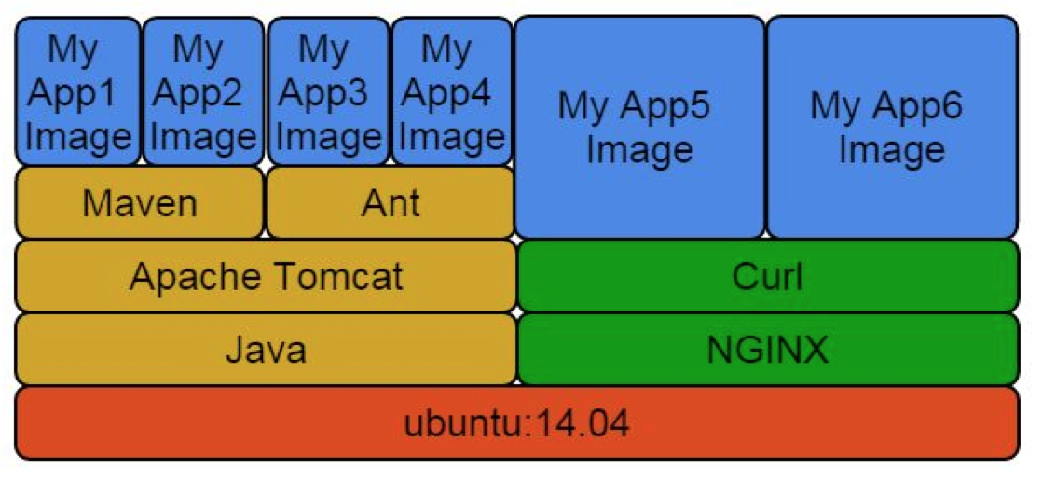
Docker Layers

Slide 13
Images and Layers
ubuntu : 200 Mb
ubuntu + R : 250 Mb
ubuntu + matlab : 250 Mb
All three: 300 Mb

Slide 14
Containers
Containers vs VMs
Containers are more lightweight.
No need for a guest OS.
Less resources.
Greater portability
Faster

Slide 15
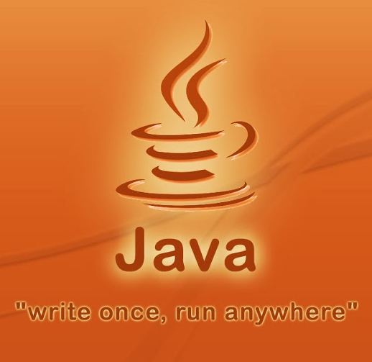
In short:
Build once run anywhere

Slide 16
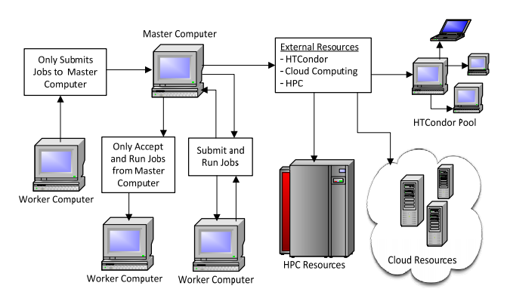
HTCondor VM and Docker universes

Slide 17
HTCondor VM and Docker universes
VM universe:
universe = vm
executable = vmware_sample_job
log = simple.vm.log.txt
vm_type = vmware
vm_memory = 64
vmware_dir = C:\condor-test
vm_checkpoint = true
queue

Slide 18
HTCondor VM and Docker universes
Docker universe:
universe = docker
docker_image = debian
executable = /bin/cat
arguments = /etc/hosts
output = out.$(Process)
error = err.$(Process)
request_memory = 100M
queue 10

Slide 19




Socker: Secure Docker containers on HPC and MTC
HPC
Sys Admin
Slurm
Compute
Node
Compute
Node
Compute
Node
Compute
Node
socker
Docker
binary
Docker Engine
Docker Engine
Docker Engine
Docker Engine
User
-rwsr-sr-x 1 root root
Docker Engine
Pull
Docker repositories
Local Registry

Slide 20
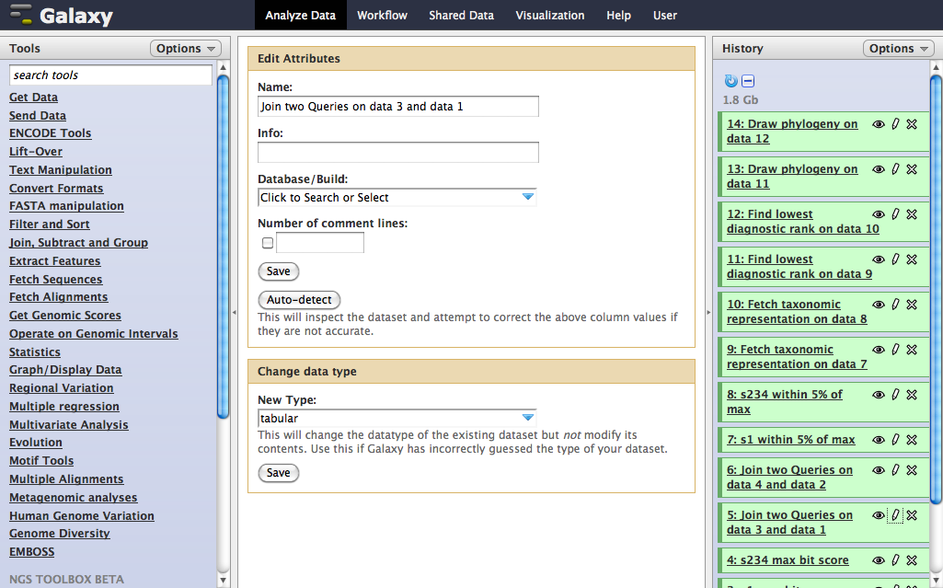
Galaxy: HPC portal for container tools

Slide 21
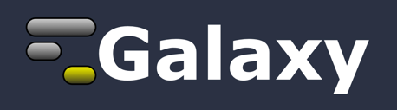
Galaxy: HPC portal for container tools
Portal
Docker Container
Slurm
Compute
Node
Compute
Node
Compute
Node
Compute
Node
Pull
Docker Engine
Docker Engine
Docker Engine
Docker Engine

Slide 22

CVMFS Repo
Reference data
container
Docker swarm
Condor
CM
container
Elastic expansion
TSD Firewall
Singularity containers
Project VLAN
Compute
container
Compute
container
Compute
container
Compute
container
Compute
container
Compute
container
Docker
Singularity
Docker
Singularity
Docker
Singularity
Docker
Singularity
Docker
Singularity
Docker
Singularity
Project storage
Sensitive data
Singularity Repo
Docker Repo
Shared Storage
bio.tools
Local
Docker Registry
Docker Images

Slide 23
Ready for fun?..
Access your VM

Slide 24


86.50.170.102
container-tutorial-[1-30]
[your-username@your-machine]$ chmod 600 docker-tutorial.pem
[your-username@your-machine]$ ssh -i docker-tutorial.pem cloud-user@86.50.170.102
[cloud-user@docker-tutorial-terminal ~]$ ssh -i docker-tutorial.pem cloud-user@<VM-name>

Slide 25
Let’s get our hands
dirty ☺
Goto the tutorial…

Slide 26
…return

Slide 27
Building a Docker Image
Interactive building
Building from a Docker File
Base Image (Disk)
Base Image (Disk)
Run
Load
Run the
Installation
procedure
Container (Memory)
Dockerfile
Installation
script
Commit
Build
New Image (Disk)
New Image (Disk)

Slide 28
Managing
Docker images

Slide 29
Interactive building Example: curl & vim
$ docker run -t -i ubuntu:14.04
root@2a896c8cdd83:/# apt-get update-y
root@2a896c8cdd83:/# apt-get install -y curl
root@2a896c8cdd83:/# apt-get install -y vim
root@2a896c8cdd83:/# exit
$ docker commit 2a896c8cdd83 youruser/curlvim:1.0
$ docker run youruser/curlvim:1.0 curl --version
curl 7.35.0 (x86_64-pc-linux-gnu) libcurl/7.35.0 OpenSSL/1.0.1f zlib/1.2.8 libidn/1.28 librtmp/2.3
Protocols: dict file ftp ftps gopher http https imap imaps ……..
$ docker login
$ docker push youruser/curlvim:1.0
Hands-on

Slide 30
Interactive building Example: Bowtie2
$ docker run -t -i ubuntu:14.04
root@2a896c8cdd83:/# apt-get update -qq --fix-missing
root@2a896c8cdd83:/# apt-get install -qq -y wget unzip
root@2a896c8cdd83:/# wget -q -O bowtie2.zip http://sourceforge.net/projects/bowtie-bio/files/bowtie2/2.2.4/bowtie2-2.2.4-linux-x86_64.zip/download
root@2a896c8cdd83:/# unzip bowtie2.zip -d /opt/
root@2a896c8cdd83:/# ln -s /opt/bowtie2-2.2.4/bowtie2 /usr/bin/bowtie2
root@2a896c8cdd83:/# rm bowtie2.zip
root@2a896c8cdd83:/# exit
$ docker commit 2a896c8cdd83 youruser/bowtie2
$ docker run youruser/bowtie2 bowtie2 --version
/bowtie2/bowtie2-align version 2.1.0
64-bit
Built on do-dmxp-mac.win.ad.jhu.edu
Tue Feb 26 13:34:02 EST 2013
……..
Hands-on
$ docker login
$ docker push youruser/bowtie2

Slide 31
Building a Docker Image from a Dockerfile
<source-directory>
Dockerfile
files
.dockerignore
$docker build -t <image-name> <source-directory>

Slide 32
Dockerfile Example: curl & vim
FROM ubuntu:14.04
MAINTAINER your name <your email>
RUN apt-get update -y
RUN apt-get install curl -y
RUN apt-get install vim -y

Slide 33
Dockerfile Example: curl & vim
FROM ubuntu:14.04
MAINTAINER your name <your email>
RUN apt-get update -y
RUN apt-get install curl -y && apt-get install vim -y

Slide 34
Dockerfile Example: Bowtie2
FROM ubuntu:14.04
RUN apt-get update -qq --fix-missing; \
apt-get install -qq -y wget unzip;
RUN wget -q -O bowtie2.zip http://sourceforge.net/projects/bowtie-bio/files/bowtie2/2.2.4/bowtie2-2.2.4-linux-x86_64.zip/download; \
unzip bowtie2.zip -d /opt/; \
ln -s /opt/bowtie2-2.2.4/ /opt/bowtie2; \
rm bowtie2.zip
ENV PATH $PATH:/opt/bowtie2

Slide 35
Managing
Docker containers

Slide 36
Inspect containers
$ docker ps # shows running containers.
$ docker inspect # info on a container (incl. IP address).
$ docker logs # gets logs from container.
$ docker events # gets events from container.
$ docker port # shows public facing port of container.
$ docker top # shows running processes in container.
$ docker diff # shows changed files in container's FS.
$ docker stats # shows metrics, memory, cpu, filsystem
http://www.jayway.com/2015/03/21/a-not-very-short-introduction-to-docker/

Slide 37
Containers
# Run a container interactively
$ docker run -it --rm ubuntu
# Run a container in the background
$ docker run -d hadoop
# Publish container port 80 on a random port on the Host
$ docker run -p 80 nginx
# Publish container port 80 on port 8080 on the Host
$ docker run -p 8080:80 nginx
http://www.jayway.com/2015/03/21/a-not-very-short-introduction-to-docker/
Notes:
--interactive (-i) – send stdin to the process.
-tty (-t) – tell the process that a terminal is present. This affects how the process outputs data and how it treats signals such as (Ctrl-C).
--rm – remove the container on exit.
ubuntu – use the ubuntu:latest image.
--detached (-d) – Run in detached mode, you can attach again with docker attach

Slide 38
Containers
# Publish container port 80 on port 8080 on the localhost interface on the Host
$ docker run -p 127.0.0.1:8080:80 nginx
# Publish all EXPOSEd ports from the container on random ports on the Host
$ docker run -P nginx
http://www.jayway.com/2015/03/21/a-not-very-short-introduction-to-docker/
Notes:
--interactive (-i) – send stdin to the process.
-tty (-t) – tell the process that a terminal is present. This affects how the process outputs data and how it treats signals such as (Ctrl-C).
--rm – remove the container on exit.
ubuntu – use the ubuntu:latest image.
--detached (-d) – Run in detached mode, you can attach again with docker attach

Slide 39
Containers
# Limit the amount of memory
$ docker run -m 256m yourapp
# Limit the number of shares of the CPU this process uses (out of 1024)
$ docker run --cpu-shares 512 mypp
# Change the user for the process to www instead of root (good for security)
$ docker run -u=www nginx
http://www.jayway.com/2015/03/21/a-not-very-short-introduction-to-docker/
Notes:
--interactive (-i) – send stdin to the process.
-tty (-t) – tell the process that a terminal is present. This affects how the process outputs data and how it treats signals such as (Ctrl-C).
--rm – remove the container on exit.
ubuntu – use the ubuntu:latest image.
--detached (-d) – Run in detached mode, you can attach again with docker attach

Slide 40
Volumes
# Start a new nginx container with /var/log as a volume (created)
$ docker run -v /var/log nginx
# Start a new nginx container with /var/log as a volume mapped to /tmp on Host
$ docker run -v /tmp:/var/log nginx
# Start a db container
$ docker run -v /var/lib/postgresql/data --name mydb postgres
# Start a backup container with the volumes taken from the mydb container
$ docker run --volumes-from mydb backup
http://www.jayway.com/2015/03/21/a-not-very-short-introduction-to-docker/
Notes:
--interactive (-i) – send stdin to the process.
-tty (-t) – tell the process that a terminal is present. This affects how the process outputs data and how it treats signals such as (Ctrl-C).
--rm – remove the container on exit.
ubuntu – use the ubuntu:latest image.
--detached (-d) – Run in detached mode, you can attach again with docker attach

Slide 41
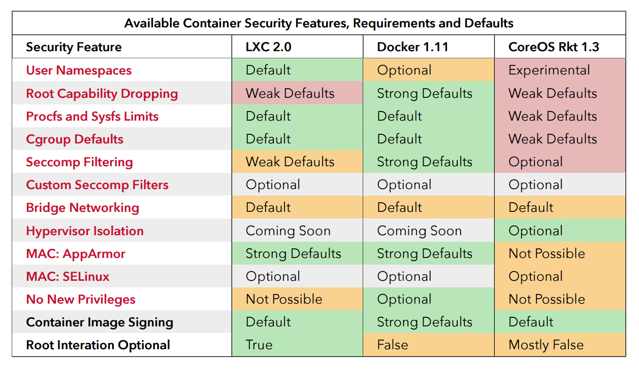
Security
source: “Understanding and Hardening Linux Containers”, page 96

Slide 42
Docker Run Platforms
Various Linux distributions (Ubuntu, Fedora, RHEL, Centos, openSUSE, ...)
Cloud (Amazon EC2, Google Compute Engine, Rackspace)
Windows, OSX: Docker Toolbox

Slide 43
Docker Ecosystem
Docker Engine or “Docker” creates and runs Docker containers. Install Docker on Ubuntu, Mac OS X, or Windows.
Docker Hub Public registry service for managing images.
Docker Registry provides open source Docker image distribution.
Docker Swarm used to host clustering and container scheduling.

Slide 44
Docker Ecosystem
Kitematic is the desktop GUI for Docker.
Docker UI is a web responsive GUI to administrate Docker
Docker Trusted Registry (DTR) supplies a private dedicated image registry.
Docker Machine automates container provisioning on your network or in the cloud. Install machine on Windows, Mac OS X, or Linux.
Docker Compose defines multi-container applications. You can install Docker Compose on Ubuntu, Mac OS X, and other systems.

Slide 45
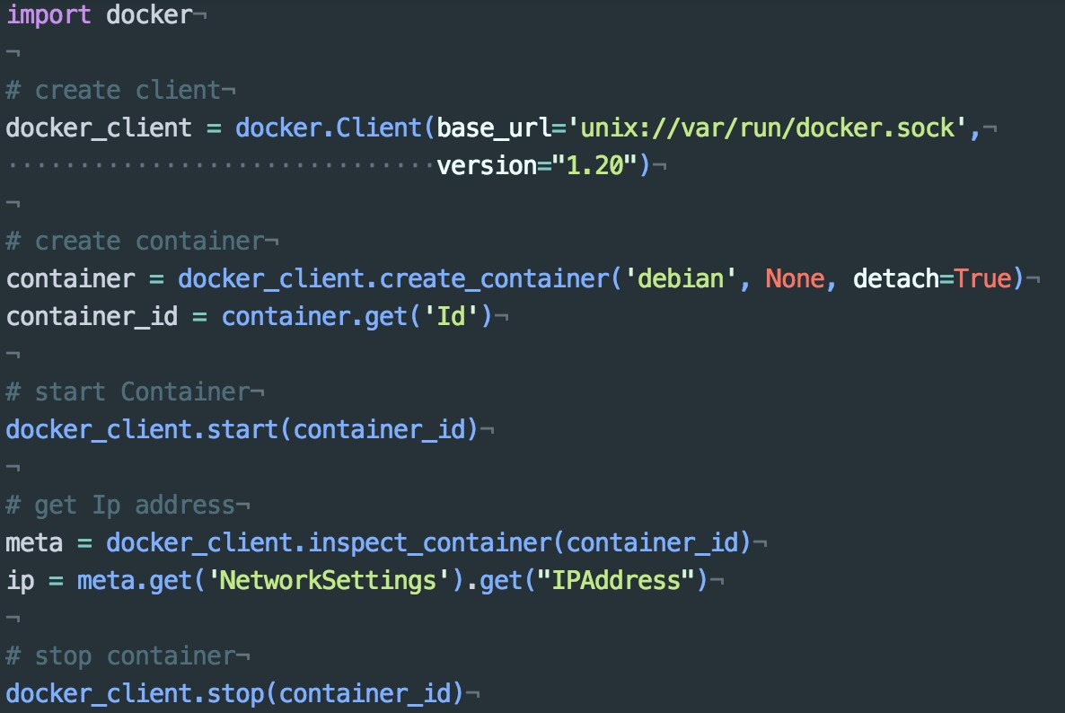
Docker APIs - Python

Slide 46
HTCondor
GYOC2: Get Your Own
Cluster in the Cloud
GYOC3: Get Your Own
Container Cluster in the Cloud
uh-iaas.no

Slide 47
Getting Condor
Available as a free download from
http://www.cs.wisc.edu/condor
Download Condor for your operating system
Available for most UNIX (including Linux and Apple’s OS/X) platforms
Also for Windows NT / XP

Slide 48
Condor Releases
Stable / Developer Releases
Version numbering scheme similar to that of the (pre 2.6) Linux kernels …
Major.minor.release
Minor is even (a.b.c): Stable
Examples: 6.6.3, 6.8.4, 6.8.5
Very stable, mostly bug fixes
Minor is odd (a.b.c): Developer
New features, may have some bugs
Examples: 6.7.11, 6.9.1, 6.9.2

Slide 49
Definitions
Job
The Condor representation of your work
Machine
The Condor representation of computers and that can perform the work
Match Making
Matching a job with a machine “Resource”

Slide 50
Job
Jobs state their requirements and preferences:
I need a Linux/x86 platform
I want the machine with the most memory
I prefer a machine in the chemistry department

Slide 51
Machine
Machines state their requirements and preferences:
Run jobs only when there is no keyboard activity
I prefer to run Frieda’s jobs
I am a machine in the physics department
Never run jobs belonging to Dr. Smith

Slide 52
Matchmaking
Jobs and machines state their requirements and preferences
Condor matches jobs with machines
based on requirements and preferences

Slide 53
Getting Started: Submitting Jobs to Condor
Overview:
Choose a “Universe” for your job
Make your job “batch-ready”
Create a submit description file
Run condor_submit to put your job in the queue

Slide 54
Choose the “Universe”
Controls how Condor handles jobs
Choices include:
Vanilla
Standard
Grid
Java
Parallel
Docker
….

Slide 55
The Architecture
Condor
CM
HTCondor Pool
Compute
Node
Compute
Node
Compute
Node
Compute
Node
Docker Engine
Docker Engine
Docker Engine
Docker Engine

Slide 56
Job script
Universe = docker
Executable = /usr/local/bin/bowtie
Arguments = -S -v 2 -m 1 /hg19 input.fastq
docker_image = genomicpariscentre/bowtie1
output = out.sam
error = bowtie.err
log = bowtie.log
queue

Slide 57
Submitting The Job
% condor_submit my_job.sub
Submitting job(s).
1 job(s) submitted to cluster 1.

Slide 58


Slide 59
Day 2
09:00 - 10:30 Docker service cluster: Docker swarm 2
10:30 - 11:00 Coffee break
11:00 - 12:30 Managing and installing HTCondor Cluster 1 12:30 - 13:30 Lunch
13:30 - 14:30 Managing and installing HTCondor Cluster 2
14:30 - 15:00 Docker job cluster: HTCondor Docker Universe
15:00 - 15:30 Singularity: Introduction
15:30 - 16:00 Coffee break
16:00 - 16:30 Singularity: Installation
16:30 - 17:30 Building and managing Singularity containers
17:30 - 19:00 Singularity and Docker in Abel/TSD, UiO

Slide 60

EOSC-Hub
a single contact point for European researchers and innovators to discover, access, use and reuse a broad spectrum of resources for advanced data-driven research.

Slide 61

EOSC-Hub T6.6 – Sensitive Data
uDocker
A simple tool written in Python, it has a minimal set of dependencies so that can be executed in a wide range of Linux systems.
No Docker installation required
Provides execution engines based on PRoot, Fakechroot, runC and Singularity as methods to execute Docker containers without privileges.

Slide 62



NeIC Tryggve
Nordic collaboration for sensitive data funded by NeIC and ELIXIR nodes of participating countries.
develops and facilitates access to secure e-infrastructure for sensitive data, suitable for hosting large-scale cross-border biomedical research studies.

Slide 63
NeIC Tryggve
Docker
Singularity
uDocker
Socker
HTCondor

Slide 64


Slide 65
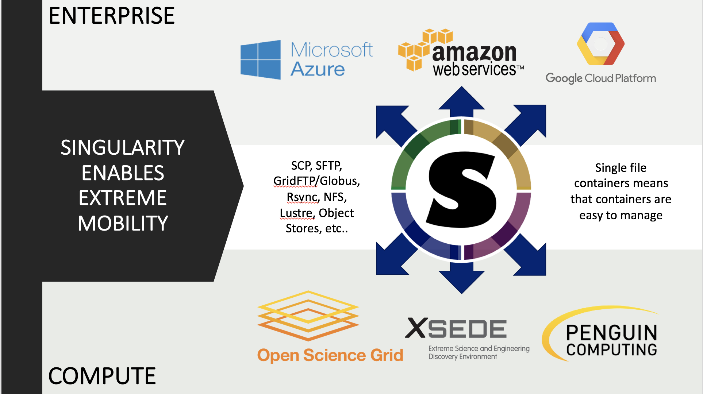

Slide 66
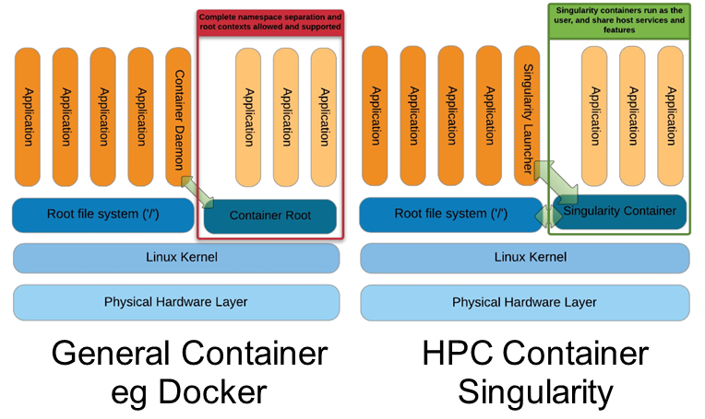
Singularity: Unprivileged containers for HPC

Slide 67
Singularity: Unprivileged containers for HPC
MPI support: build-in support for MPI (OpenMPI, MPICH, IntelMPI)
Data analysis example: Computing principal components for the first 10,000 variants from the 1000 Genomes Project chromosomes 21 and 22:
wget https://…/chr21.head.vcf.gz
wget https://…/chr22.head.vcf.gz
LANG=C CHUNKSIZE=10000000 mpirun -x LANG -x CHUNKSIZE -np 2 singularity run -H $(pwd) variant_pca.img

Slide 68
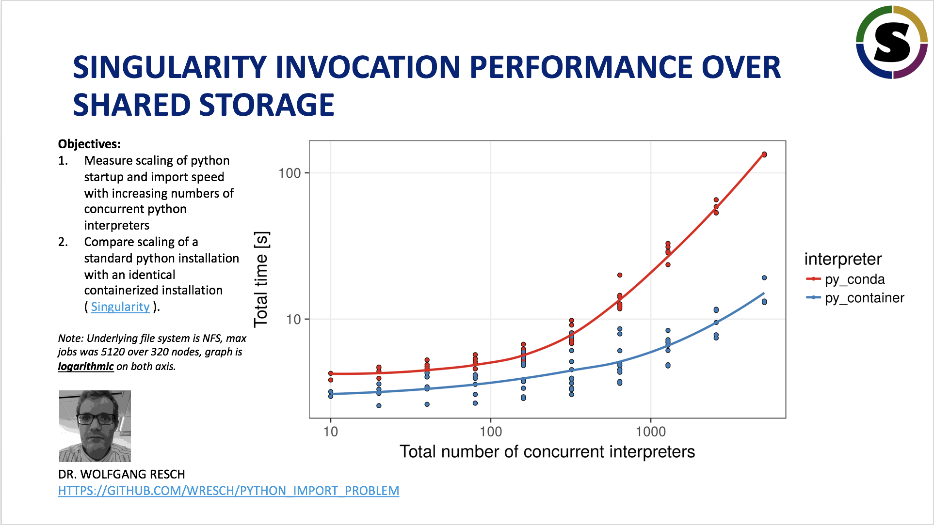

Slide 69
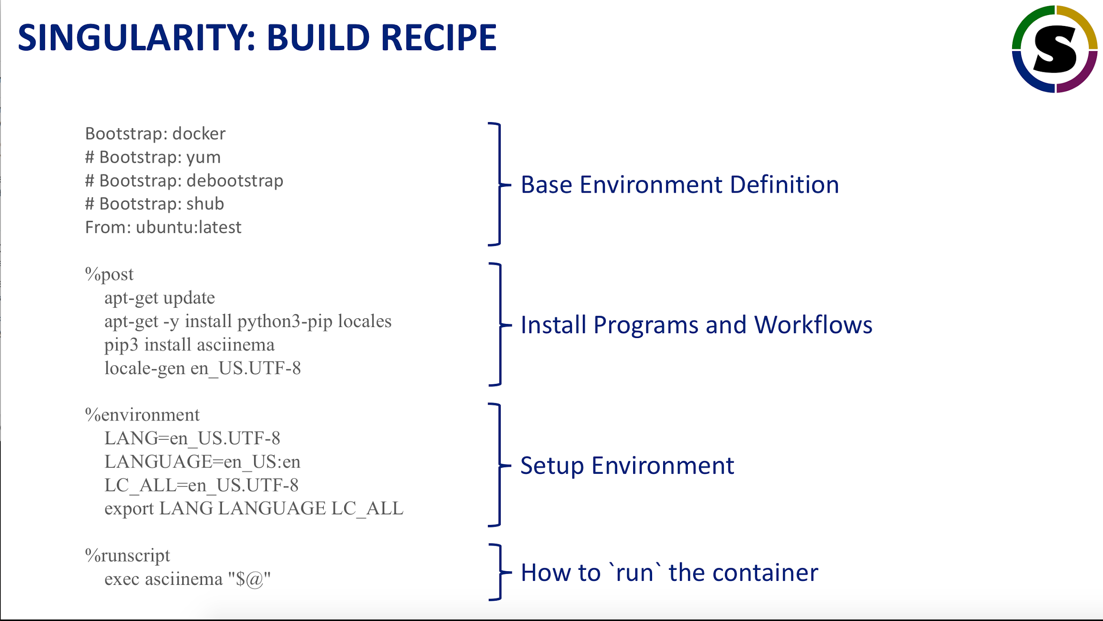

Slide 70
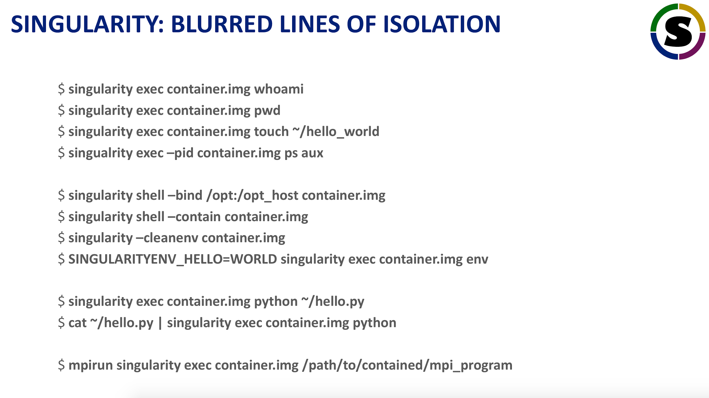

Slide 71
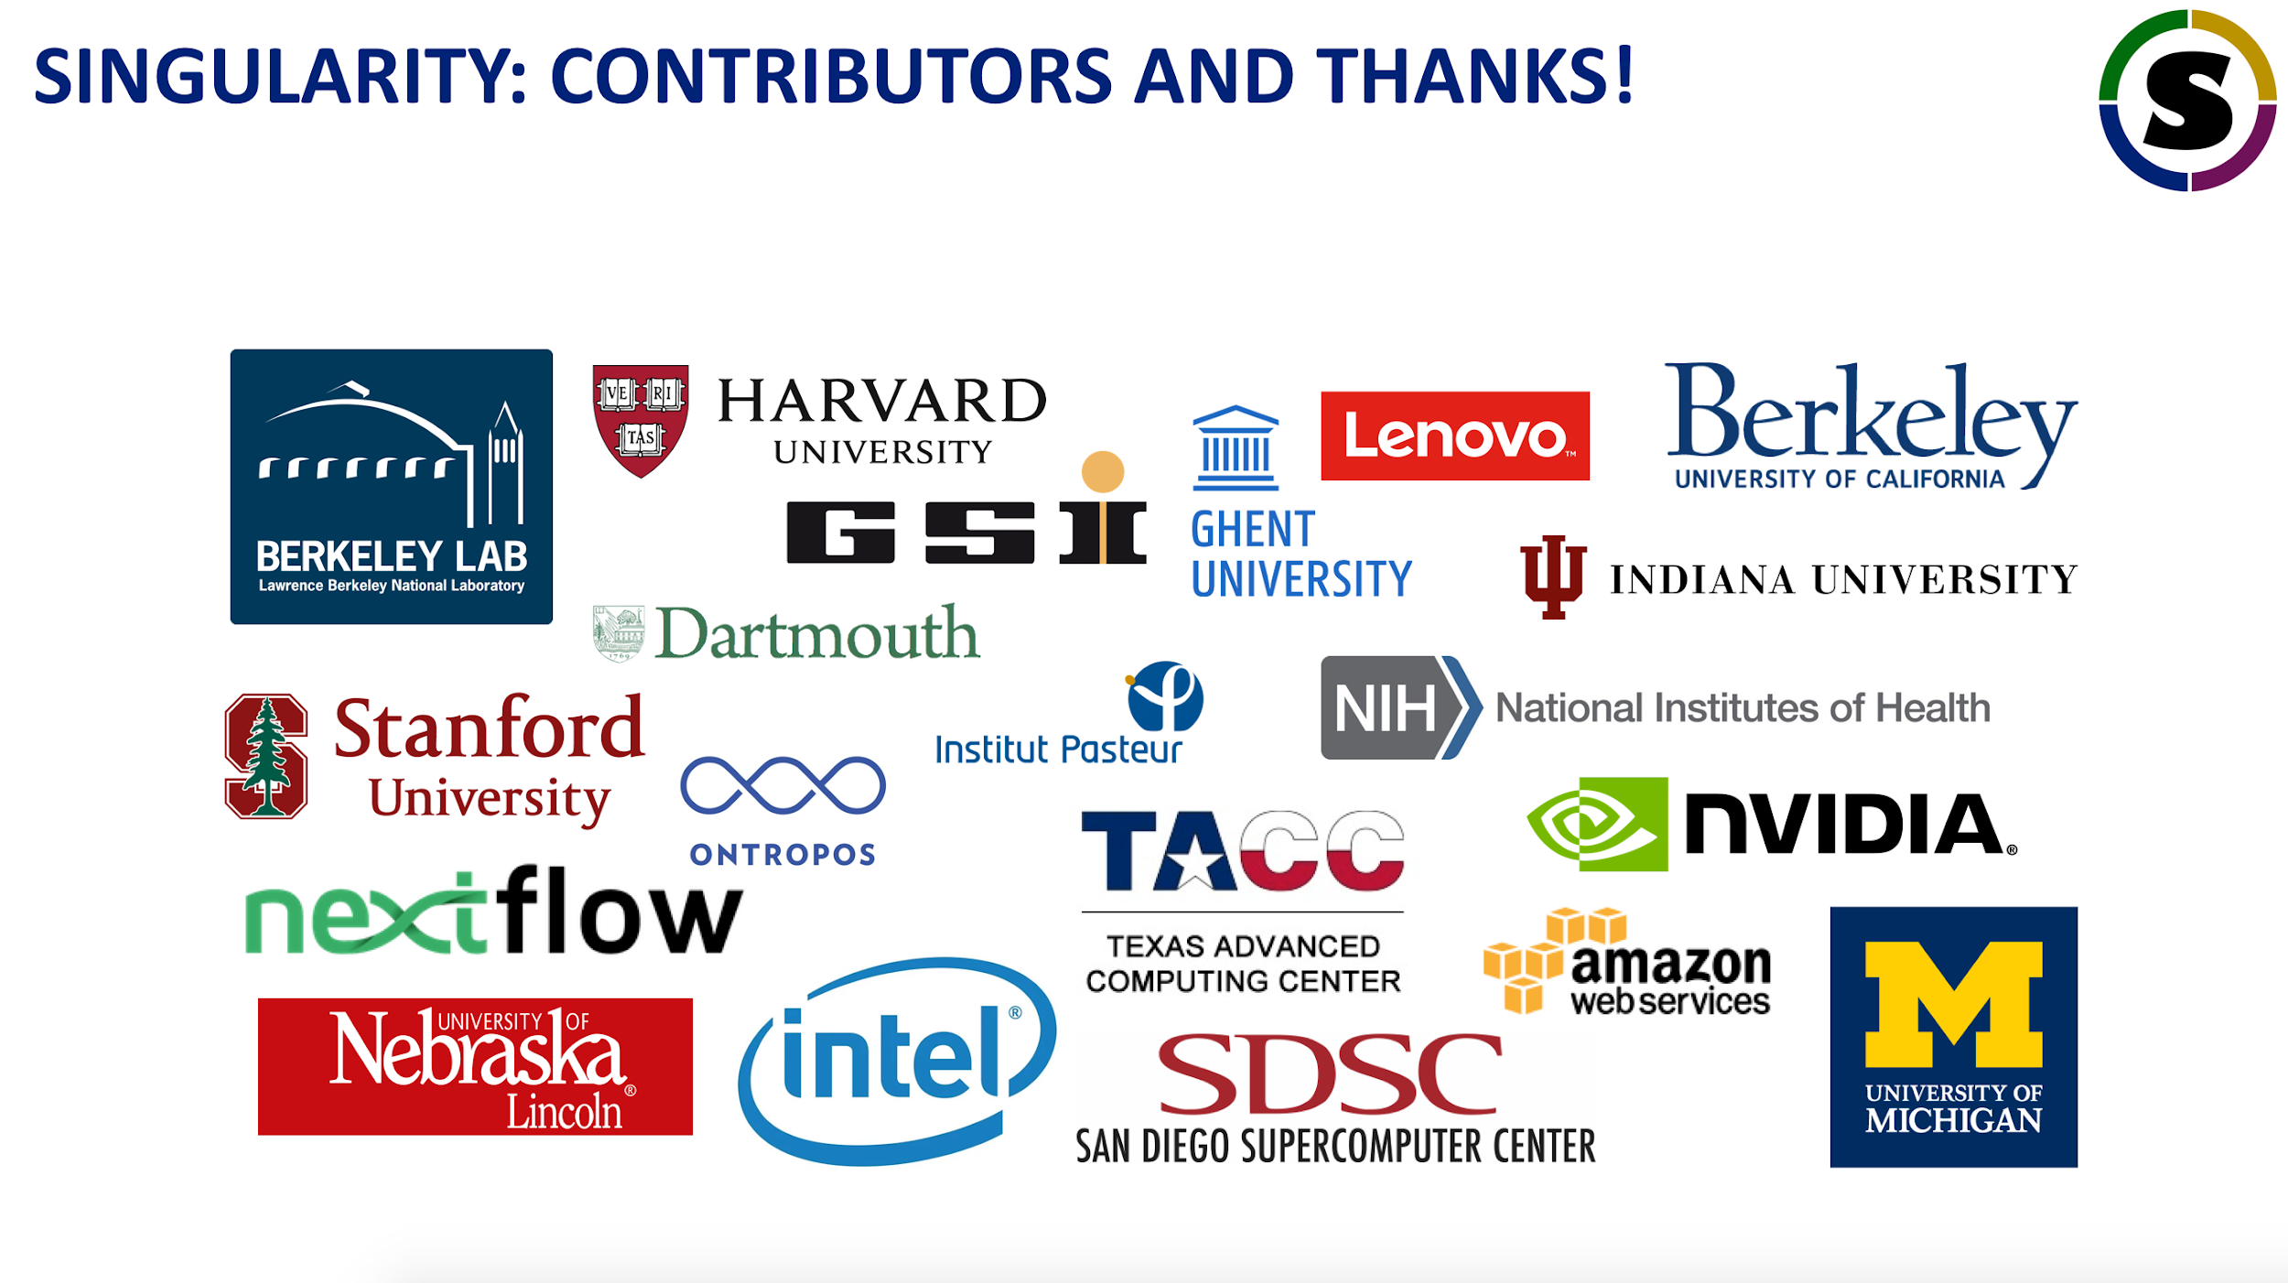

Slide 72
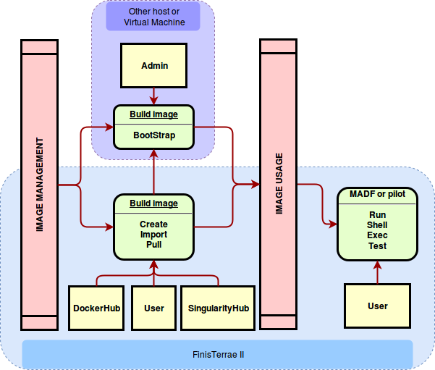
Singularity: Unprivileged containers for HPC
MPI testing (MSO4SC ):
Architecture

Slide 73
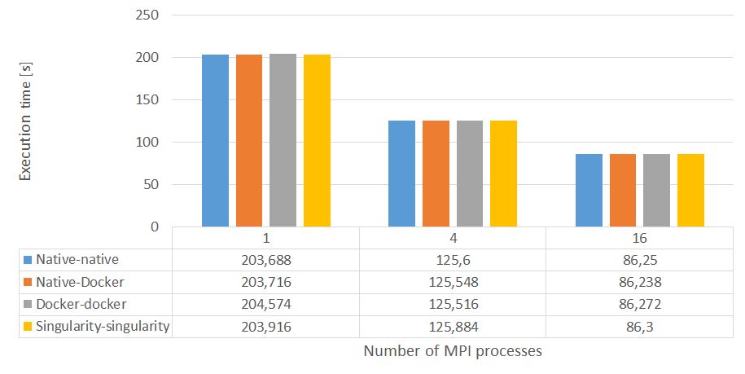
Singularity: Unprivileged containers for HPC
MPI testing (MSO4SC ): Feel++ Lid driven cavity 2D simulation benchmark
Notes:
Lid driven cavity problem in 2D as a sample simulation using two hosts and MPI between the host and the Containers

Slide 74
Singularity: Unprivileged containers for HPC
MPI testing (CINECA):
Quantum Espresso: 64 water molecules has been made 200 steps of a car-parrinello quantum dynamics. The version of Quantum Espresso used is 6.1.0, the version of openmpi is 2.1.1, and the compiler used for them and for the prerequisites libraries is gnu 4.8.2.
Quantum Espresso version 6.1.0 + Openmpi 2.1.1 + gnu compiler | Inside Singularity Container | Bare Metal
1 GALILEO node, 16 MPI processes | 24m51.51s CPU 25m22.07s WALL | 24m50.68s CPU 25m22.14s WALL
Notes:
Quantum Espresso ‎[69] is an integrated suite of Open-Source computer codes for electronic-structure calculations and materials modelling at the nanoscale. It is based on density-functional theory, plane waves, and pseudopotentials.

Slide 75
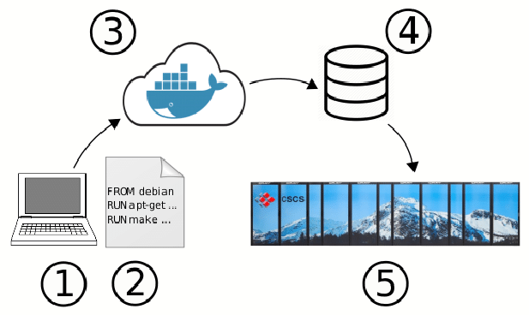
Shifter: Enabling docker containers for HPC
Notes:
1. shifter officially only supports the Centos6 and 7 and Cl6 (for cray) operating systems. 2. lack of a proper installation manual and troubleshooting documentation (this was improved in the meantime to some extent) 3 .Shifter has some dependecies and built-ins that makes it unsuitable for integration with other tools. For example shifterexclusively requires MUNGE to authenticate nodes and SLURM for running jobs (they say that more scheduler systems will be supported in the future). Shifter also ships its own image repository, which can only be populated from docker images at the moment.

Slide 76
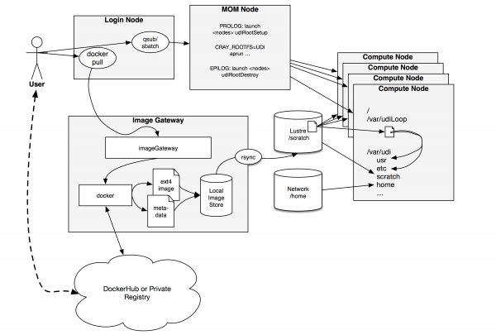
Shifter: Enabling docker containers for HPC

Slide 77
Shifter: Enabling docker containers for HPC
Pull the image from docker hub
$ module load shifter $ shifter pull docker:<image-name>
In the Slurm script: Run the container
#!/bin/bash #SBATCH --image=docker:<image-name> #SBATCH --nodes=1 #SBATCH --partition=regular module load shifter srun -n 32 shifter <command>

Slide 78
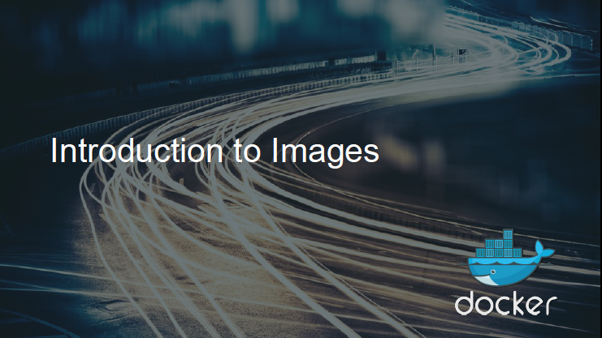

Slide 79
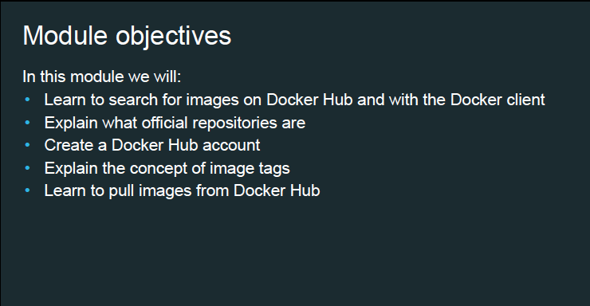

Slide 80
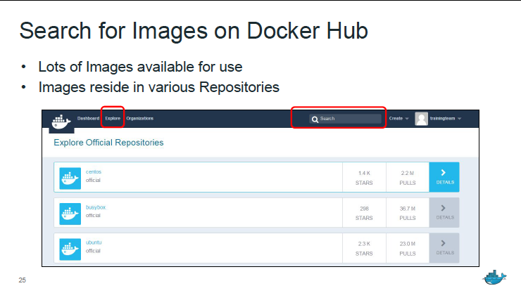

Slide 81
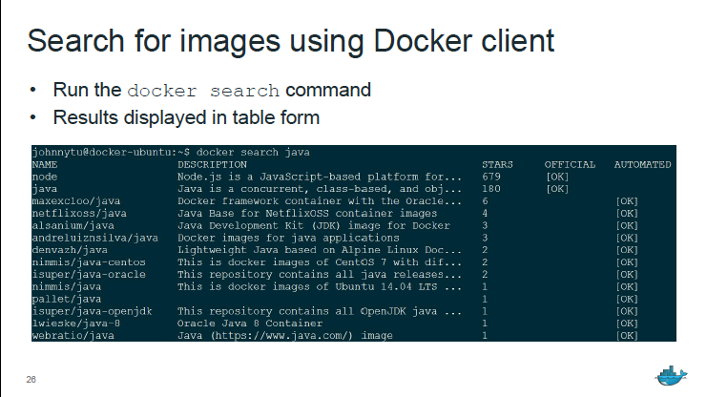

Slide 82
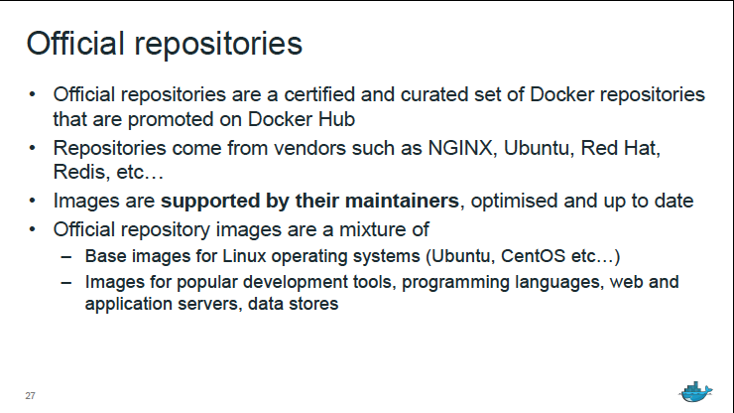

Slide 83
